Slide 1

3D Printing and CAD
Understanding the basics of 3D Design
Notes:
Designed by Melissa Daoud and Devendra Ranjan for the Makerspace Career Academy.

Slide 2
Agenda
1. Introduce 3D Design and CAD
2. Discuss how to break objects down into basic shapes
3. Introduce TinkerCAD
4. Discuss TinkerCAD's interface and how to utilize shapes/tools
5. Demo: Let's make a snowman!
6. Group project - 3D Design Show & Tell

Slide 3
What is CAD?
CAD stands for Computer Aided Design.
CAD is a "manufacturing process that allows us to digitally create 2D drawings or 3D models of future products, allowing designers and engineers visualize a product’s construction, before fabricating it." (Goodwin University)
Who uses CAD?
Architects
Game Designers
Artists
Manufacturers
Engineers

Slide 4
How does 3D Design begin?
The design typically begins with a hand drawn 2D model, utilizing some basic views:
Top, bottom, left, right, front, back, and an angled view (called an isometric view).
If you designed your model on a 3D CAD program, you could then "pull" the model out, converting it from 2D to 3D.
Example:
Think about drawing a basic square on a piece of paper and then pulling that square up and out to make a cube.

Slide 5
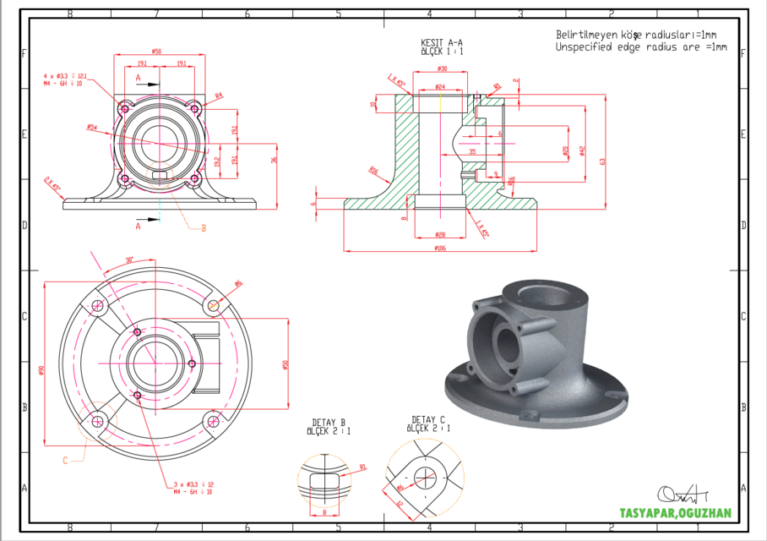
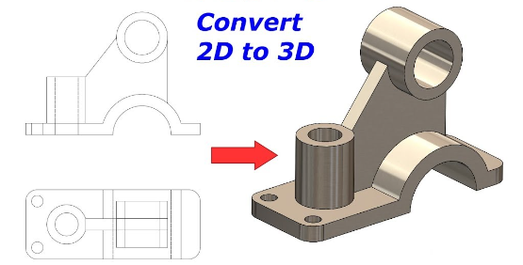
Converting 2D to 3D
Converting a design with both internal and external specs
Converting a design with top, bottom, and side specs

Slide 6
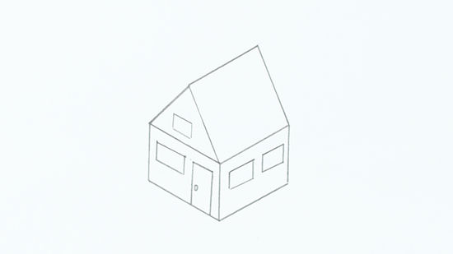
How do I start designing a model?
First, think of what you want to make.
Then start drawing a basic sketch of the object.
Think about what the object looks like from all angles.
Take this house for example:
Look at the shapes that make up this house, what do you see?
Triangles, rectangles, squares...do you spot an oval?

Slide 7
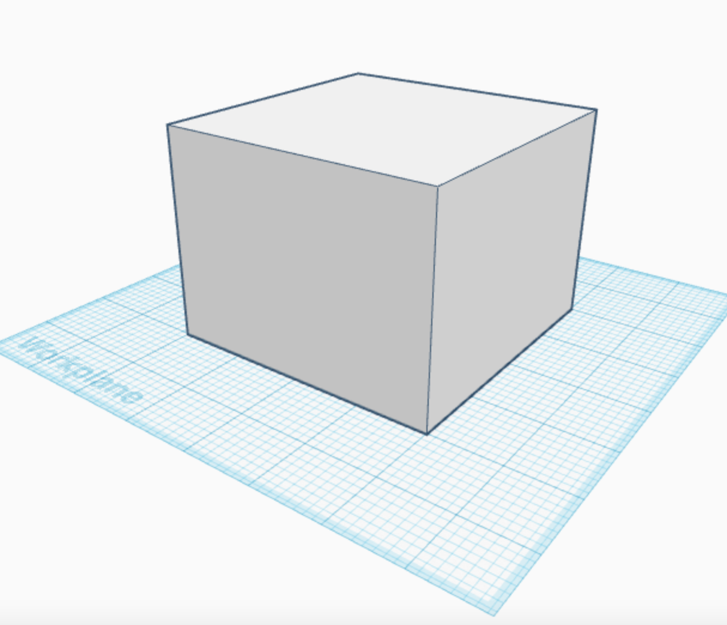

Slide 8
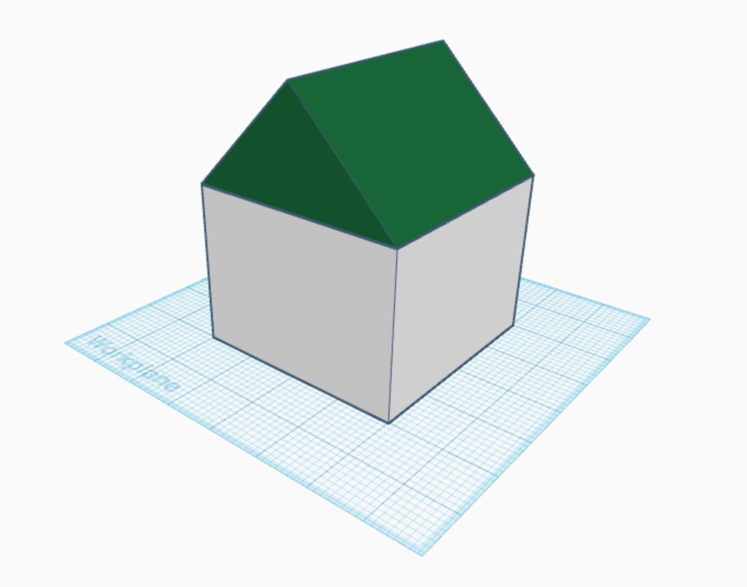

Slide 9
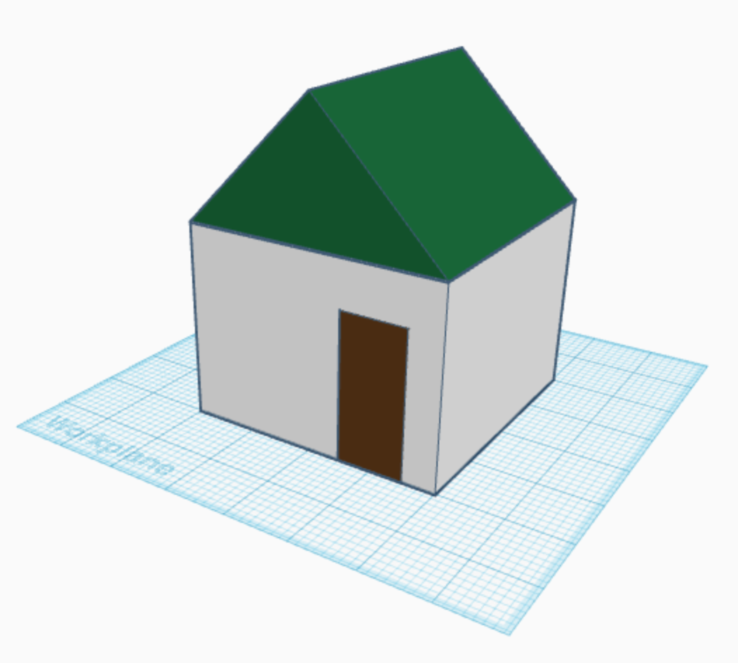

Slide 10
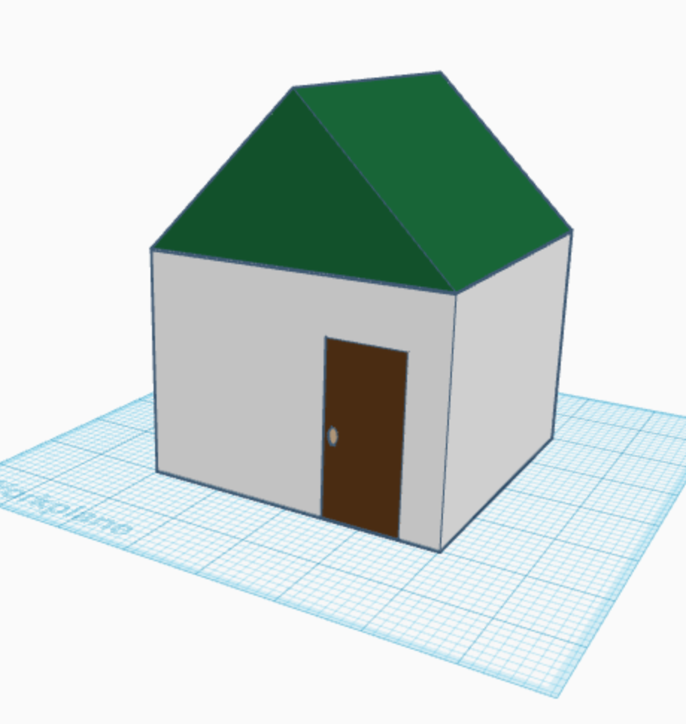

Slide 11
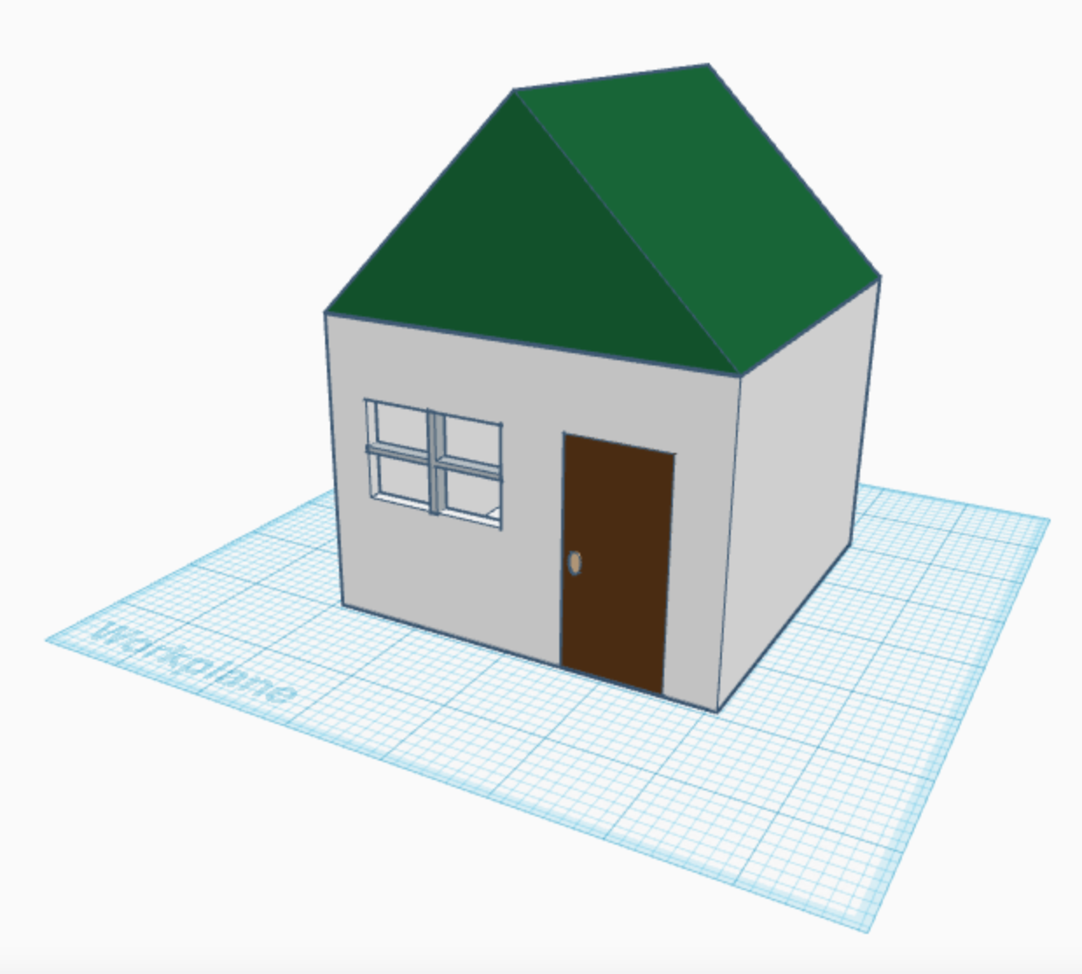

Slide 12
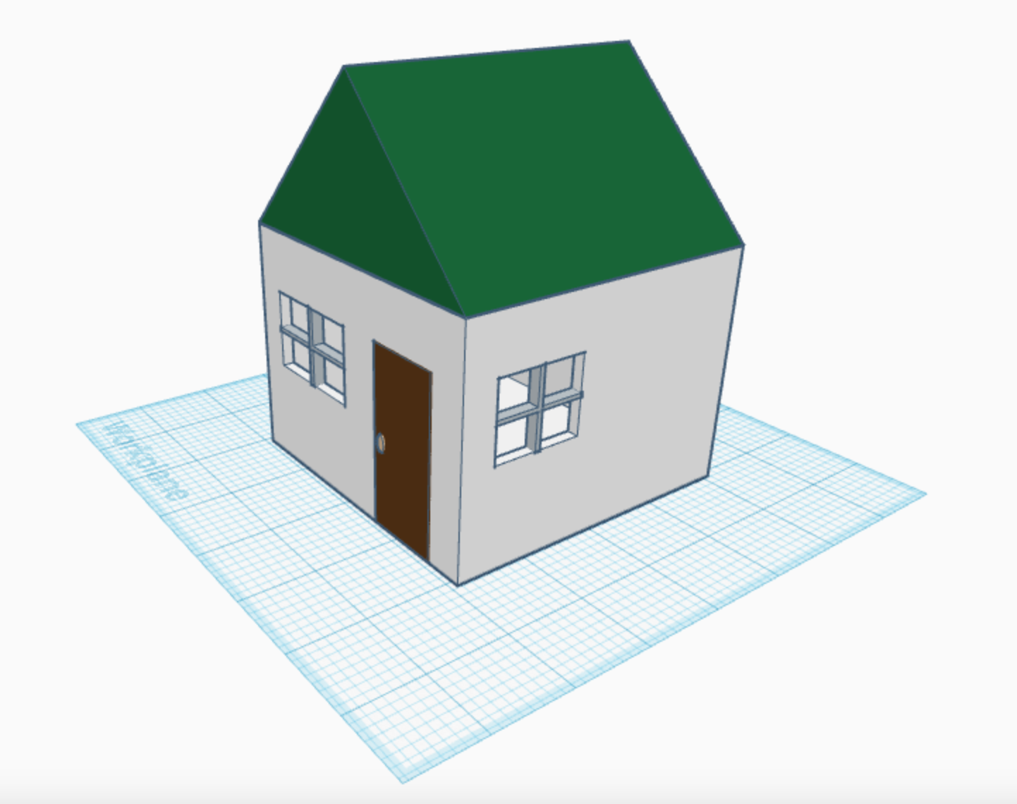

Slide 13
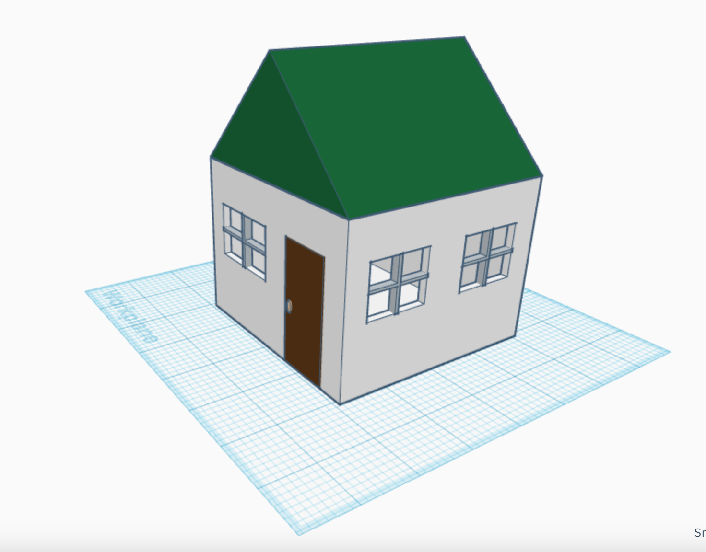

Slide 14
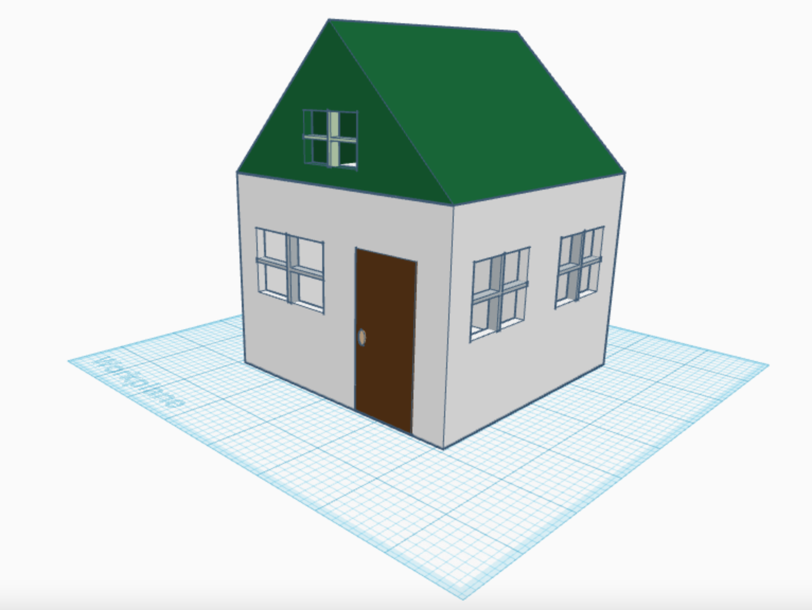

Slide 15
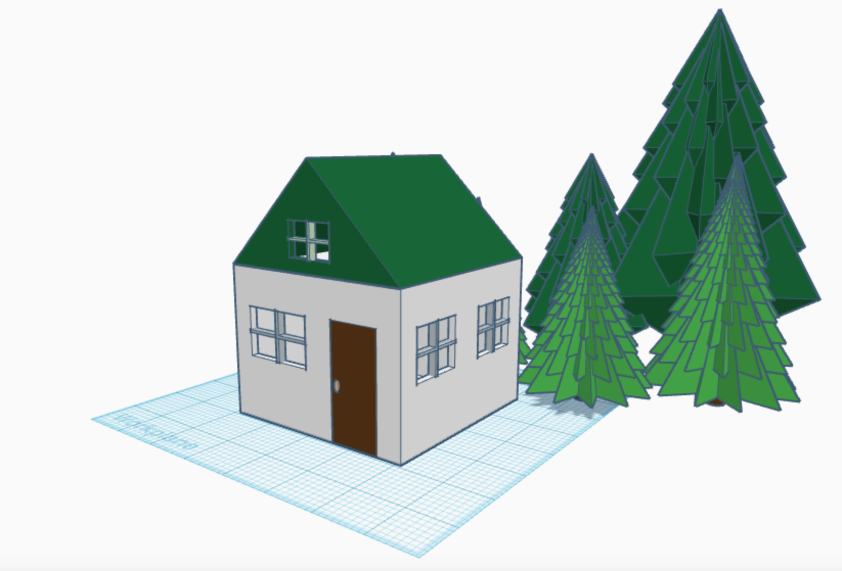

Slide 16
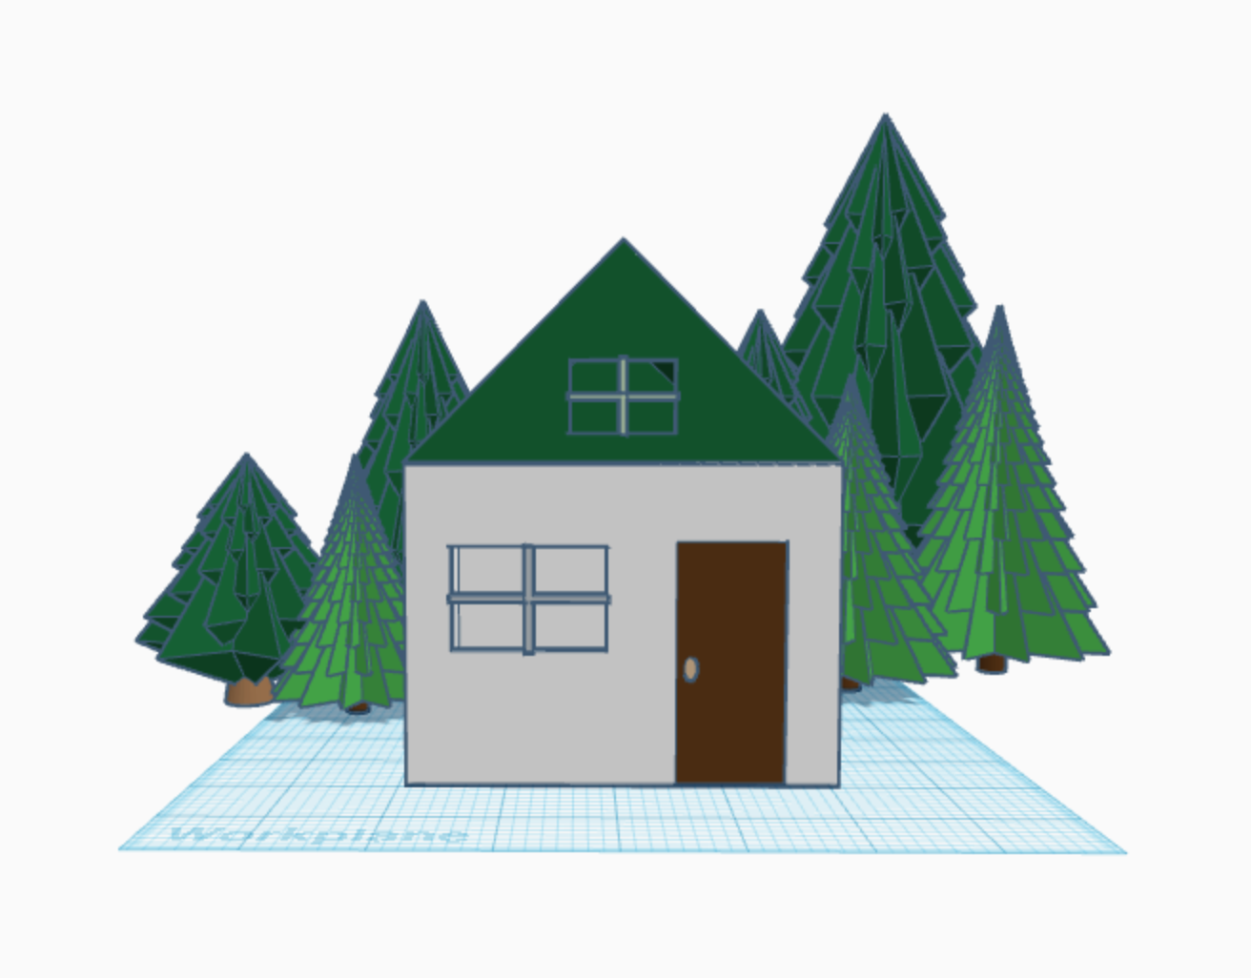

Slide 17
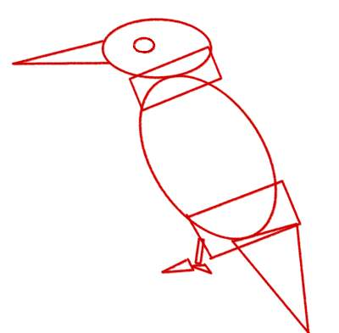
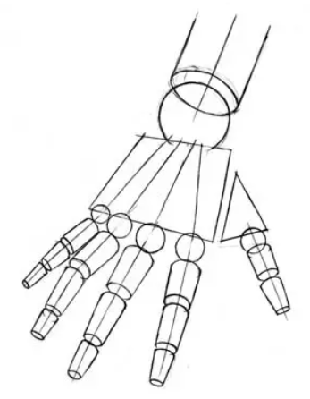
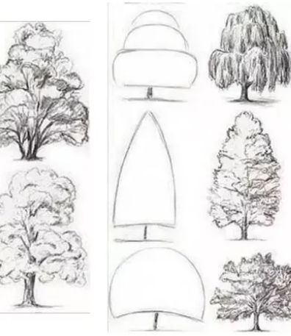

Everything starts with basic shapes! What do you see?

Slide 18
Introducing TinkerCAD
Now it's time to make our own 3D designs – with TinkerCAD!
TinkerCAD is a free, web-based app you can use to design 3D models, electronics, and code.
It's simple drag-and-drop interface allows us to quickly make models with a click of a button.
Let's check out TinkerCAD's interface and make a Snowman!

Slide 19

Let's Build a Snowman!
Here's a snowman all dressed up for winter. Examine the picture carefully.
What shapes make up Mr. Snowman?

Slide 20
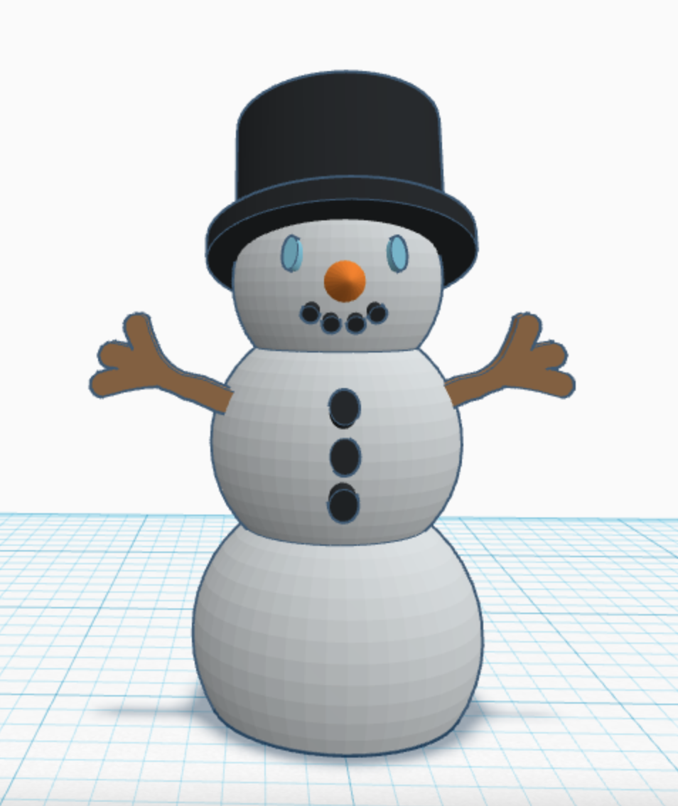
Mr. Snowman in 3D

Slide 21
Sources:
Design Launchers: What is 3D CAD Modeling
https://www.designlaunchers.com/what-is-3d-cad-modeling
Goodwin University
https://www.goodwin.edu/enews/computer-aided-design-definition/
Designed by Melissa Daoud and Devendra Ranjan for the Makerspace Career Academy.

